Slide 1
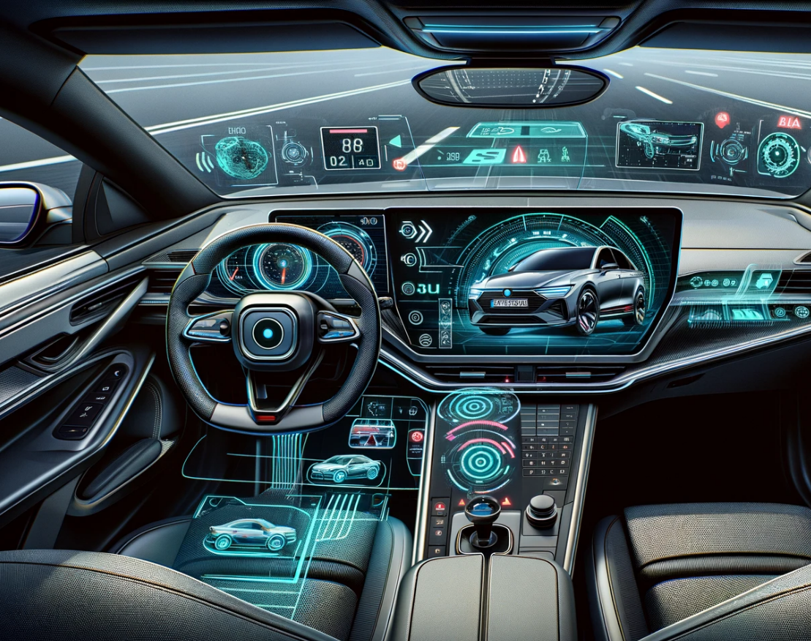
Advanced Driving Assistance System
Unveiling the Technological Backbone of Modern Vehicles
Elbek Bakiev - 7216249
Farhad Gulizaga - 7216770

Slide 2

Agenda
Hardware Model:
What is ADAS?
System High-Level Diagram
ADAS Hardware Flow
Multi-Core Processor
Memory
Sensors
Communication Interfaces
Actuators
APP4MC Model
Software Model:
Software
Scheduler
Tasks
Runnables
Events
APP4MC Model

Slide 3
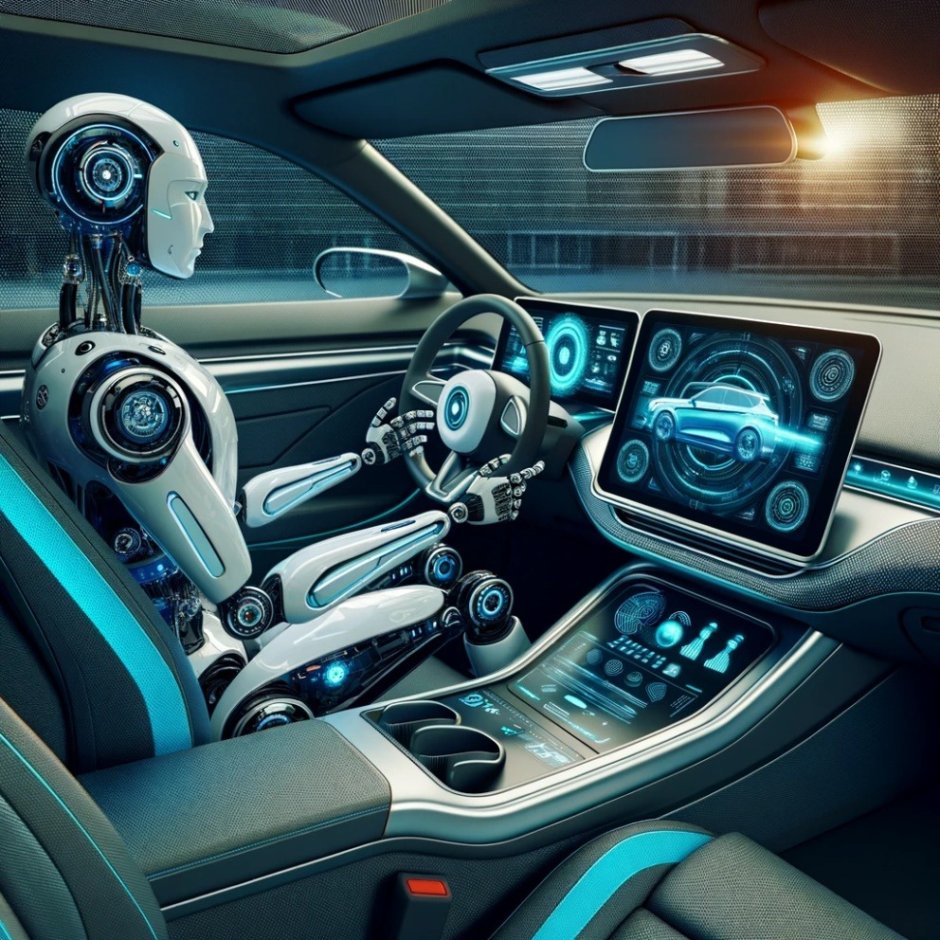
What is ADAS?
Automated Driving (AD)
Enables vehicles to operate autonomously.
Covers a range of tasks:
Steering
Braking
Complex maneuvers
Categorized into levels 0-5 based on automation extent.
Advanced Driver Assistance System (ADAS)
Aims to assist, not replace, the driver.
Features include
Lane departure warnings
Adaptive cruise control
Parking assistance
Utilizes sensors and algorithms for environmental interpretation.
Enhances safety and driving comfort.

Slide 4
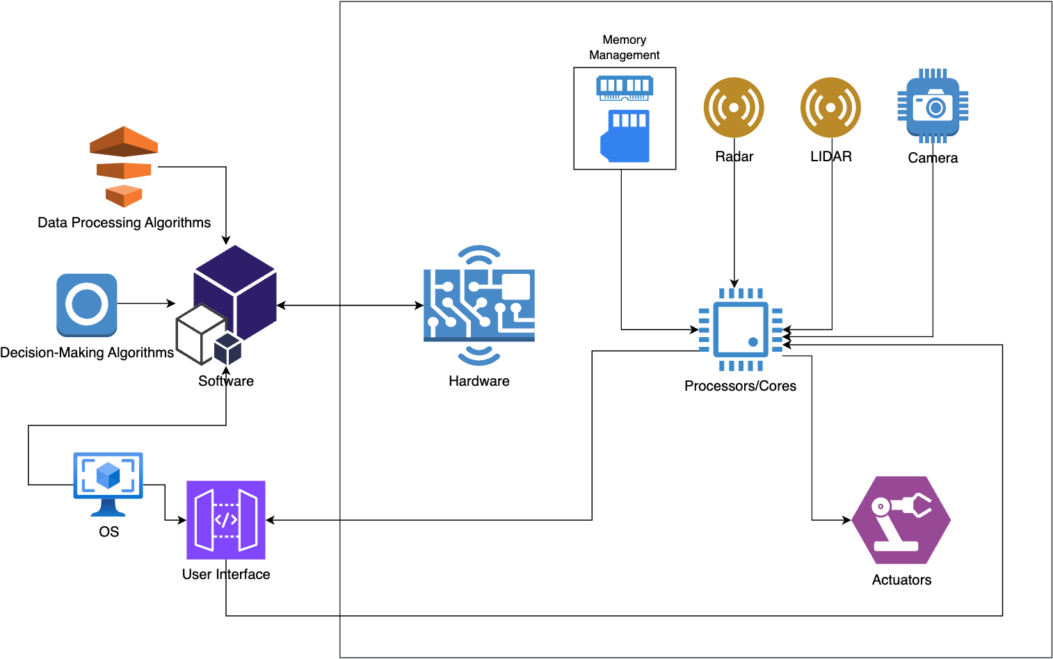
System High-Level Diagram
Hardware:
CPU
Memory Management
Sensors
Actuators
Software:
Operating System
User Interface
Decision-Making Algorithms
Data Processing

Slide 5

ADAS Hardware Flow
Information Acquisition:
Sensors (cameras, radar, LIDAR) collect real-time data.
Data includes images, distances, and object detection.
Initial Data Processing:
Sensor data is temporarily stored in high-speed RAM.
Preliminary processing of data for immediate reaction needs.
Data Transfer:
Processed data is transferred to the multi-core processor.
Utilizes CAN Bus and Ethernet for efficient communication.
Advanced Processing:
A multi-core processor analyzes data.
Core allocation: specific cores handle specific tasks (e.g., object detection, decision-making).
Decision-Making and Command Generation:
Processed data leads to decision-making.
Commands generated for vehicle control (steering, braking).
Command Execution:
Actuators receive commands from the processor.
Physical actions executed (adjusting steering, applying brakes).
Long-term Data Storage and Learning:
Relevant data and decisions are stored in Flash Memory.
Data used for system learning and firmware updates.

Slide 6

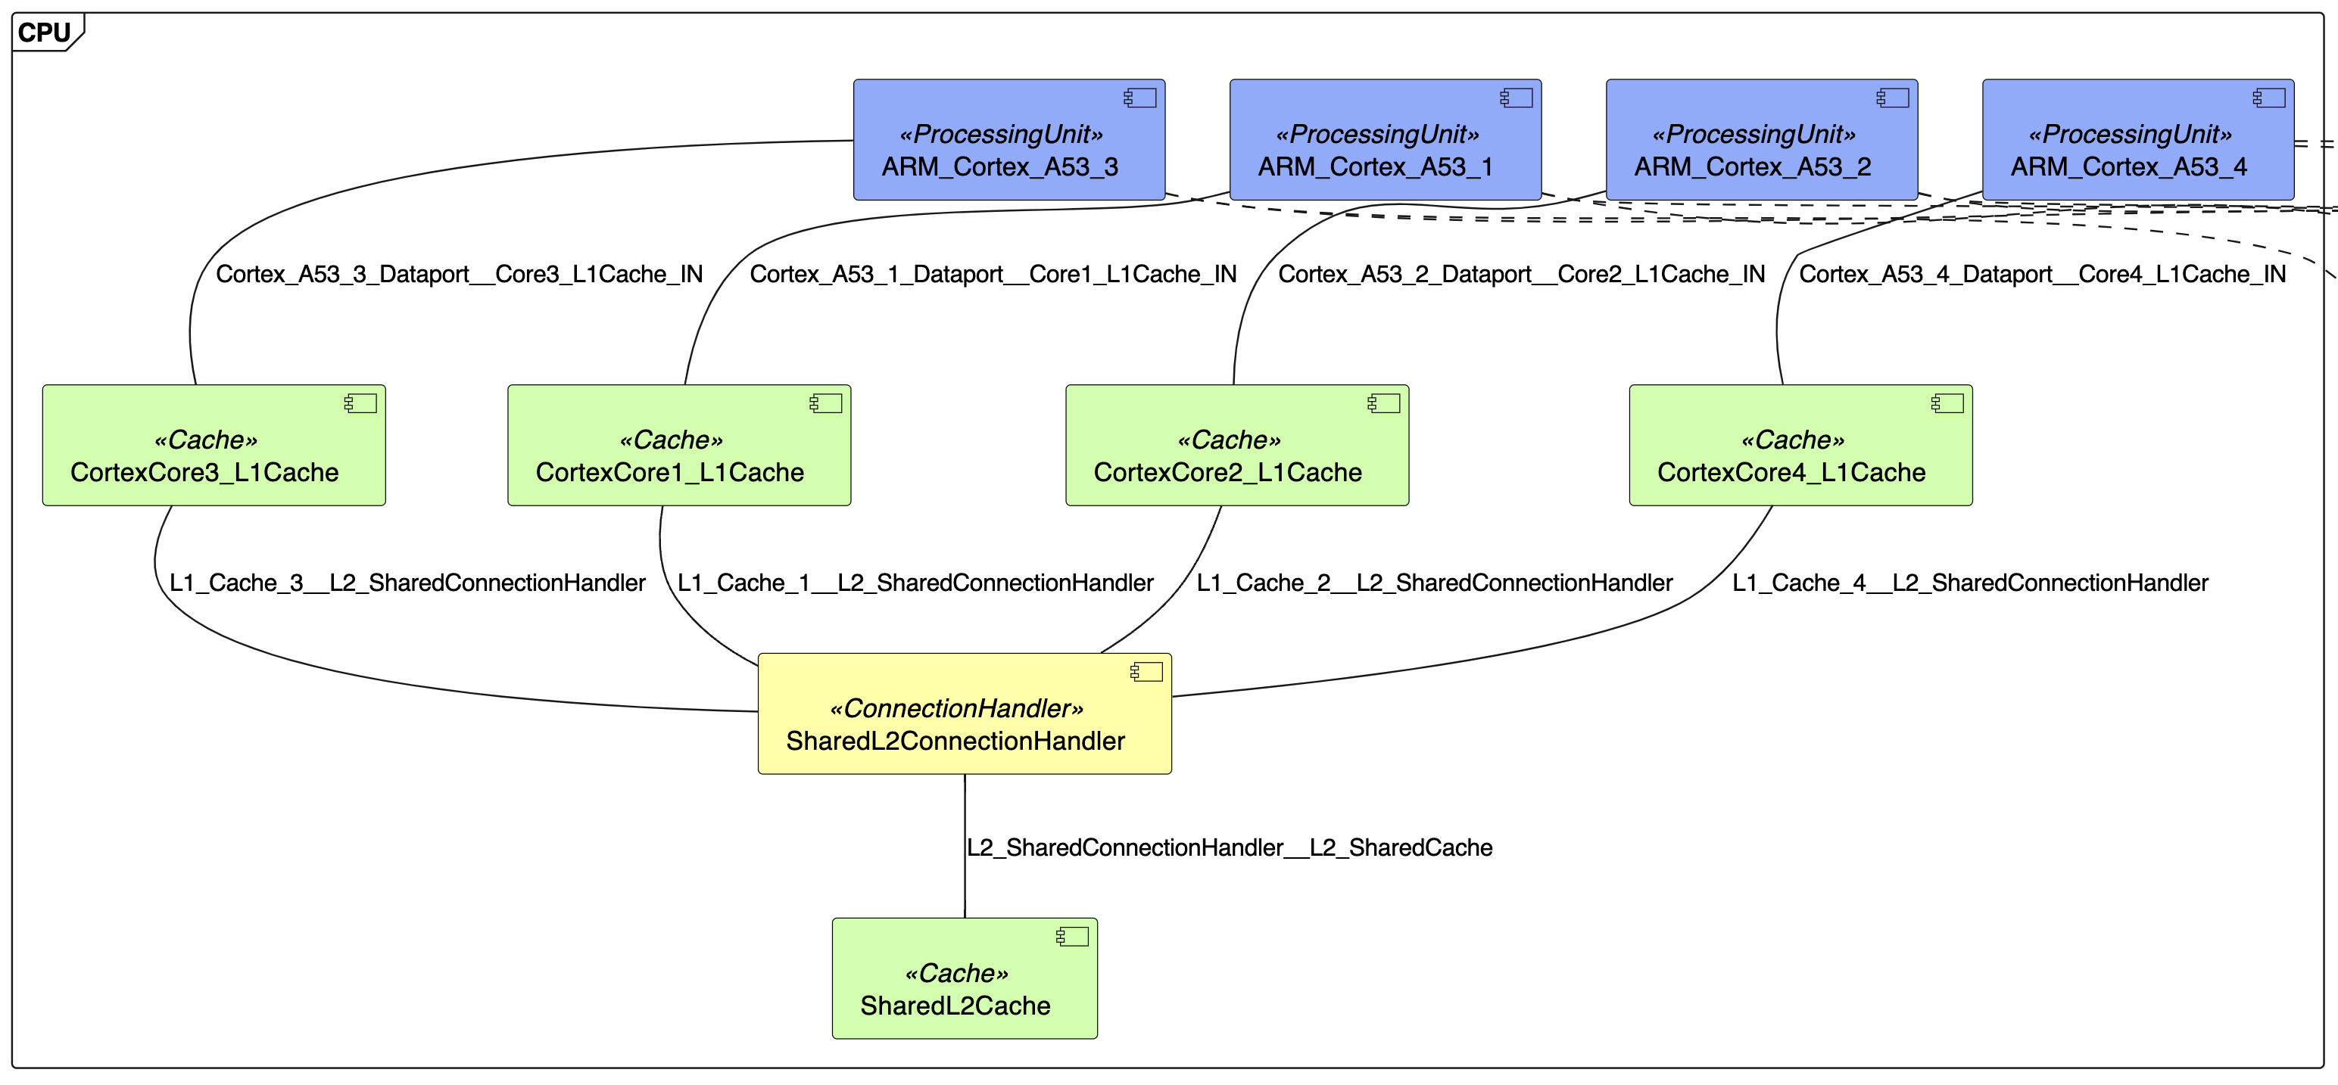
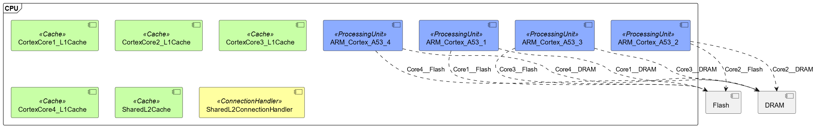
The Brain - Multi-Core Processor
ARM Cortex A53:
Core 1:
Dedicated to high-priority tasks like object detection
Emergency decision-making.
Core 2 and 3:
Handling sensor data processing classification tasks.
Share the load for balancing.
Core 4:
Reserved for actuator control
Lower-priority tasks
Communication with other vehicle systems.

Slide 7

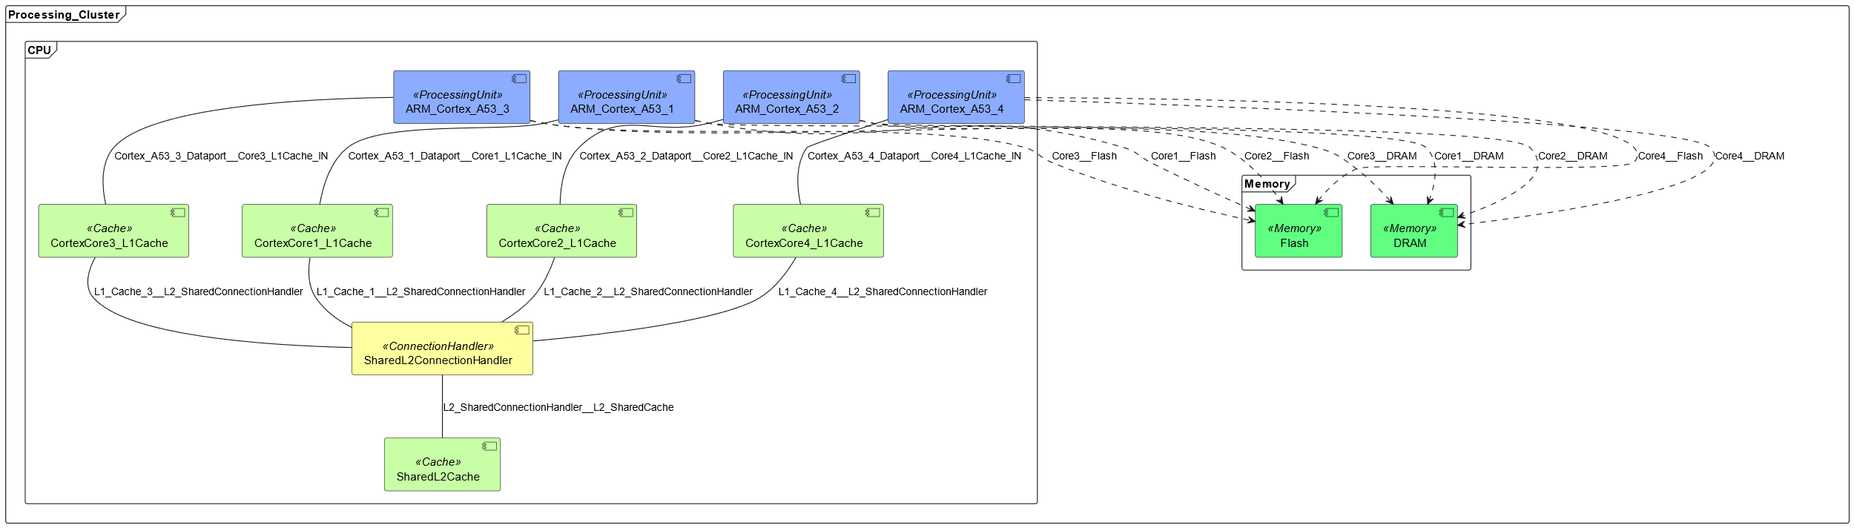
Memory Components
RAM (Random Access Memory) Maximum Specifications
Frequency:
Up to 3200 MHz or higher for high-performance ADAS systems.
Enables faster data processing for complex tasks.
Capacity:
Can reach 32 GB or more in advanced, data-intensive ADAS systems.
Allows handling of larger data sets and more simultaneous processes.
Flash Memory Maximum Specifications
Speed:
Maximum read speeds can be up to 550 MB/s.
Maximum write speeds can reach up to 500 MB/s.
Speeds depend on the Flash Memory type (e.g., high-end NAND).
Capacity:
Can extend up to 1 TB or more for high-end systems.
Suitable for systems with extensive map data and sophisticated software features.

Slide 8
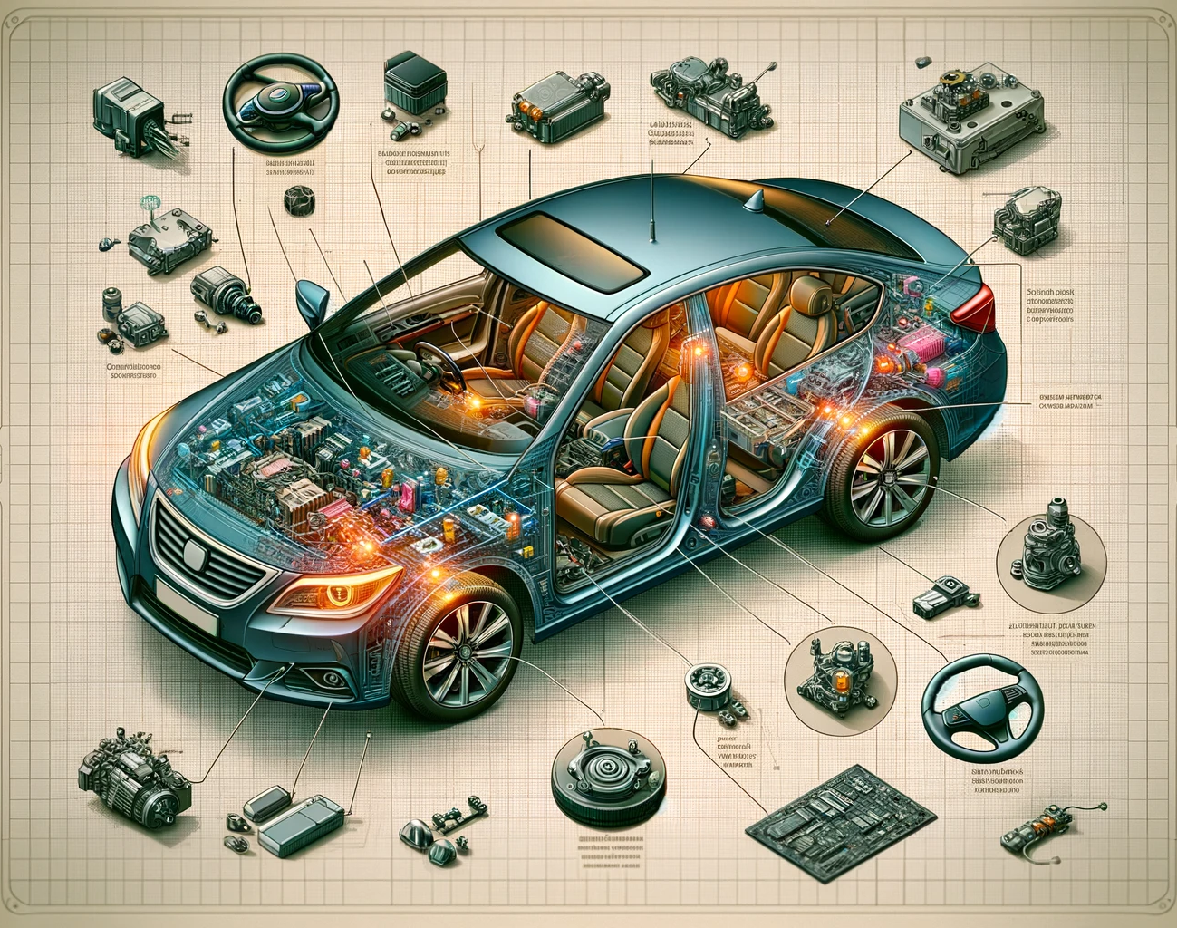
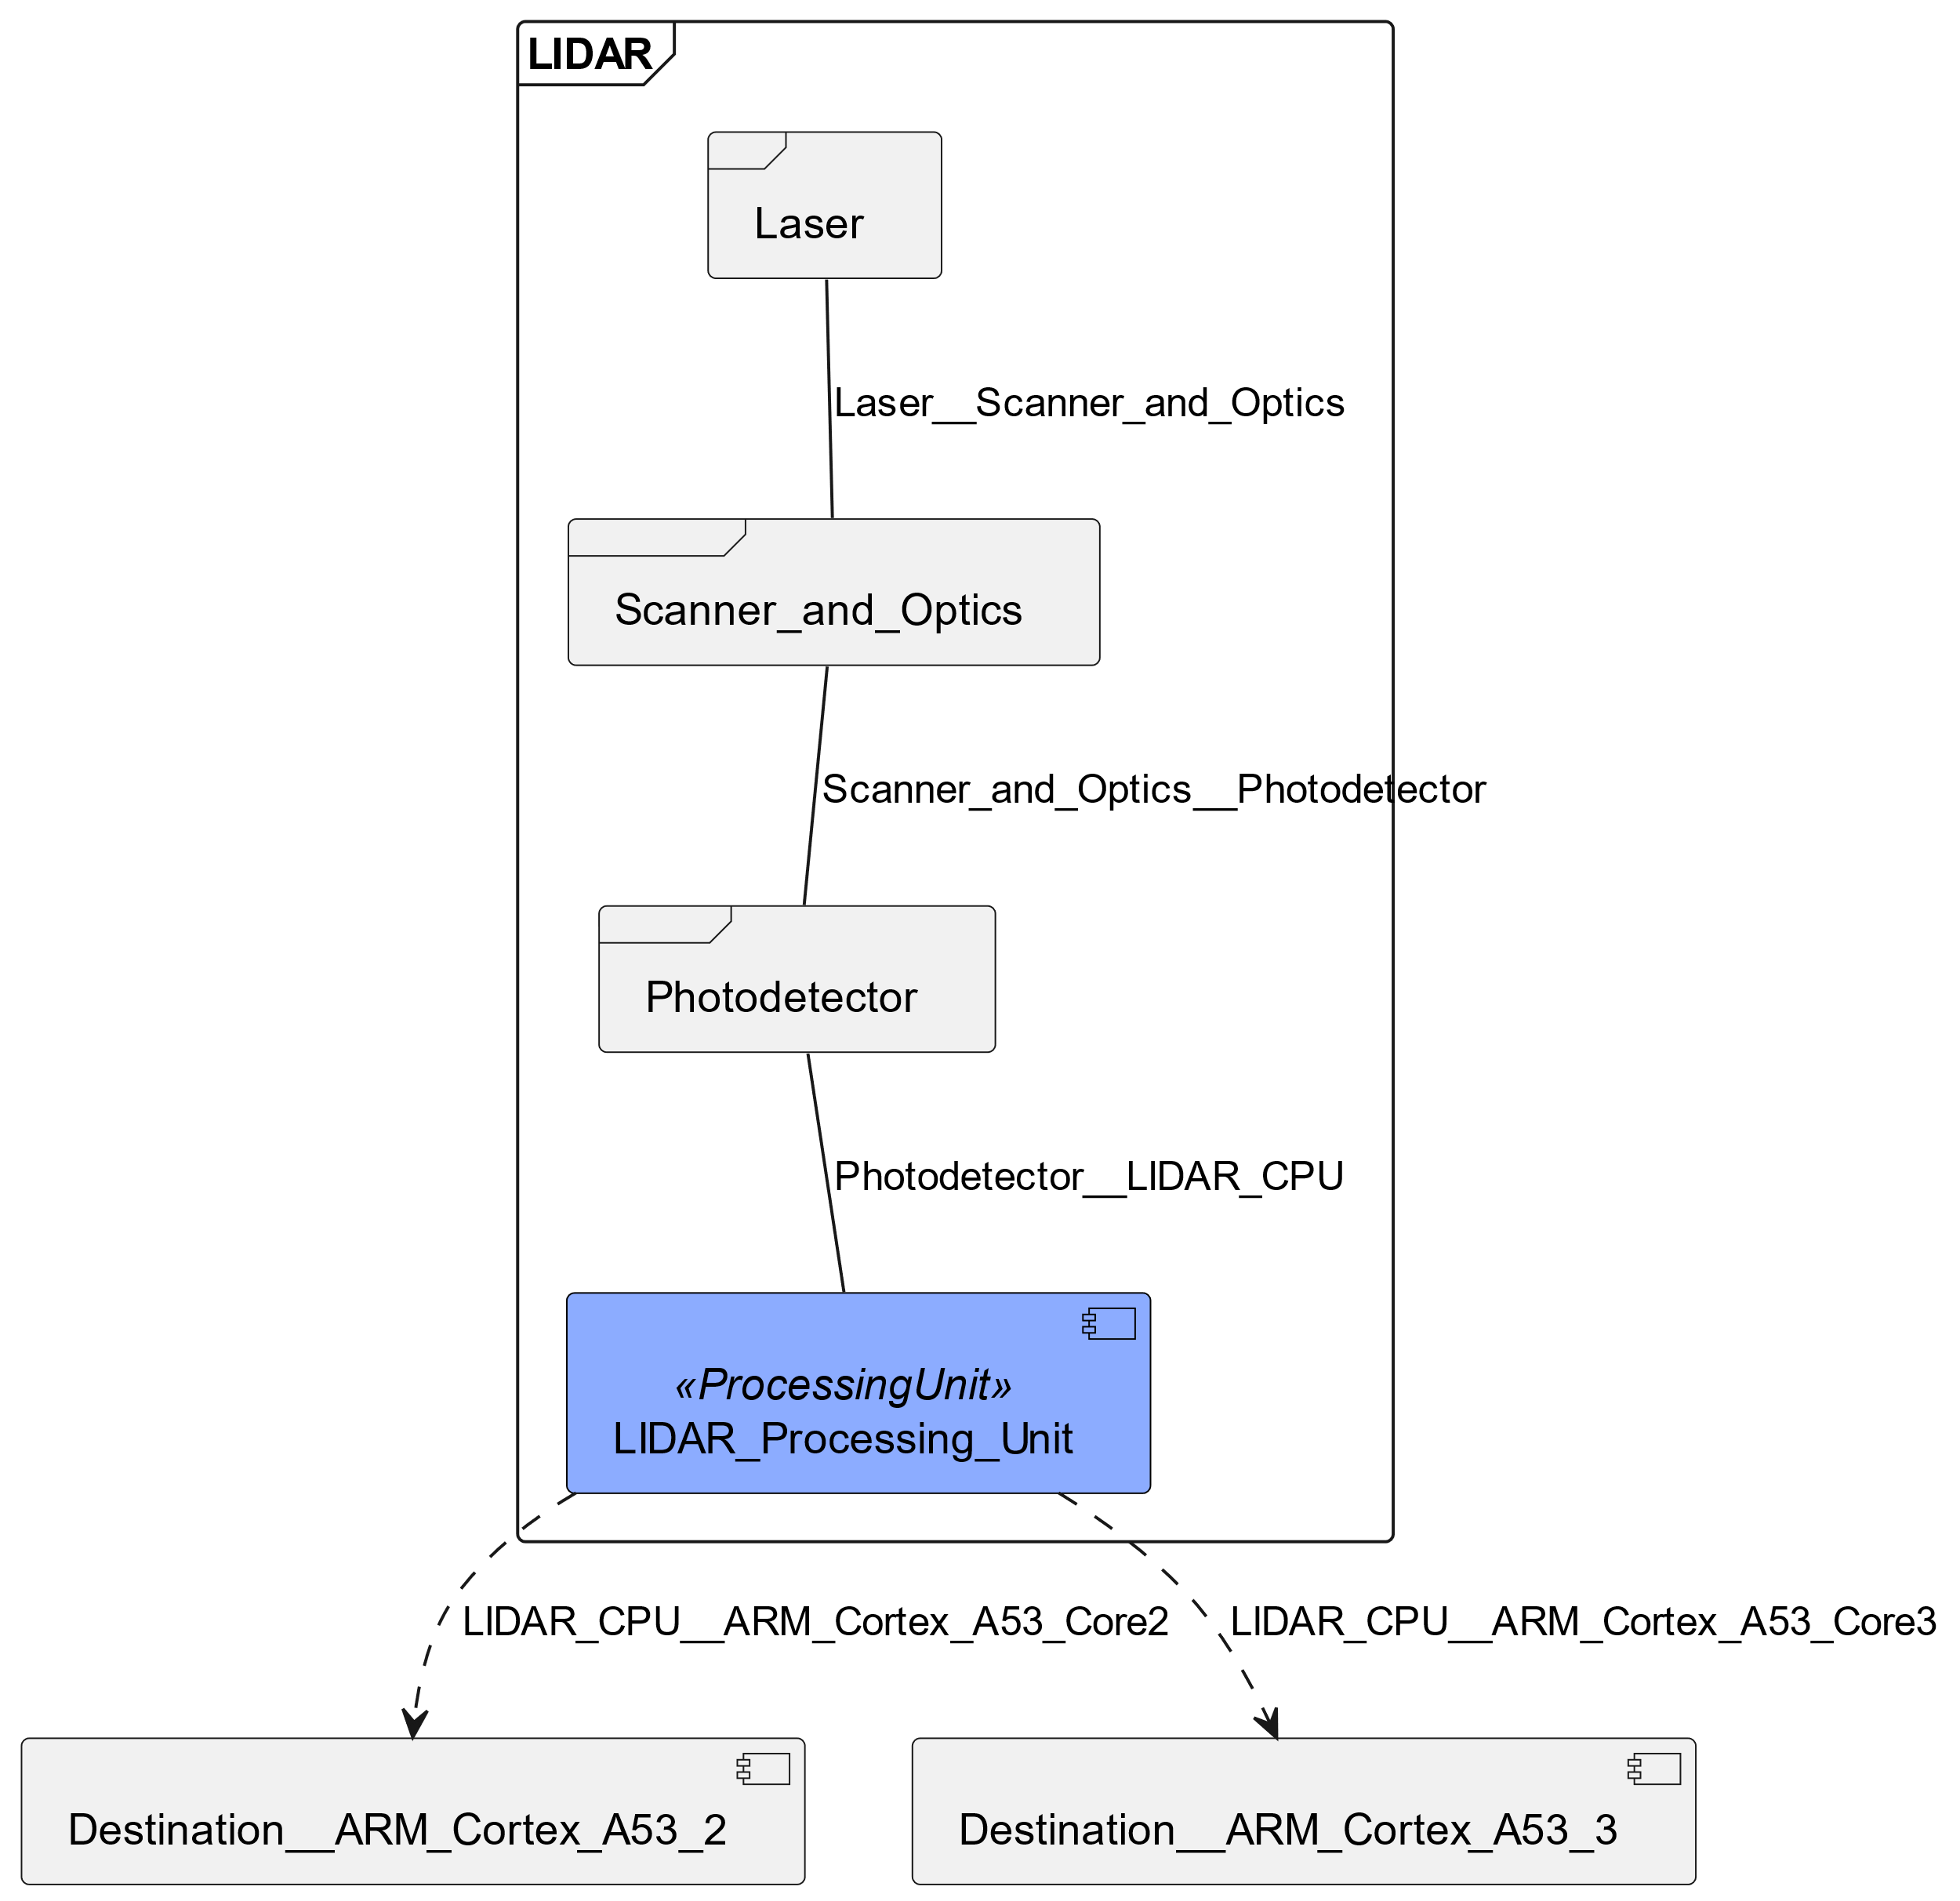
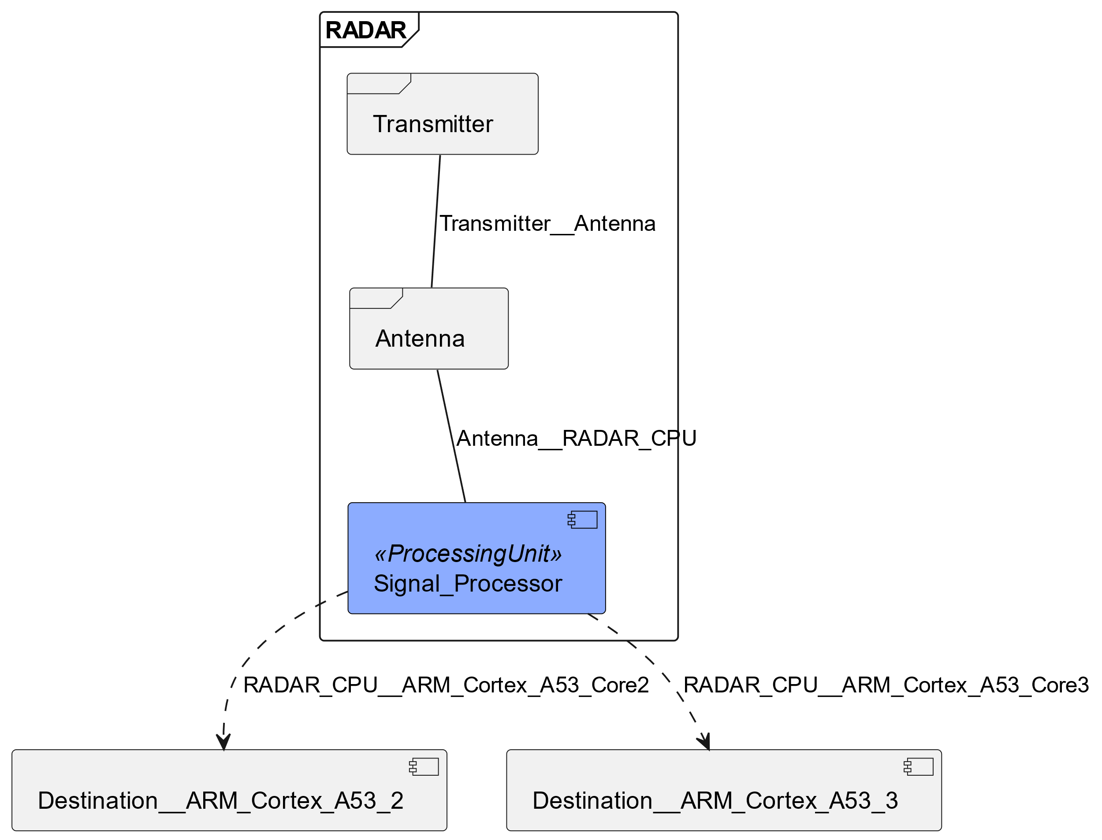
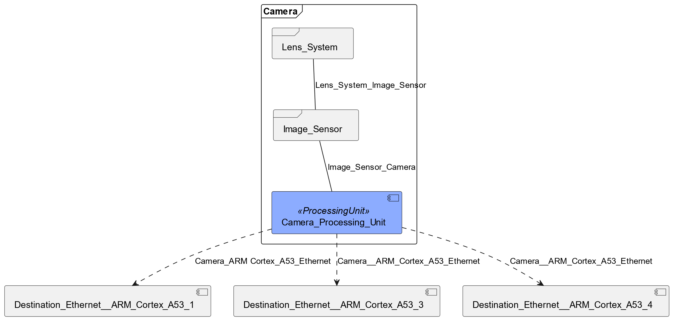
Sensing the World - Sensors

Slide 9

Communication Interfaces
CAN Bus (Controller Area Network) Connection
Purpose:
Facilitates communication between various microcontrollers and devices within the vehicle.
Characteristics:
Robust and reliable, designed to operate in the automotive environment.
Supports data transfer rates up to 1 Mbps.
Functionality:
Transmits sensor data and control messages between ADAS components.
Helps in diagnostics and monitoring of vehicle systems.
Advantages:
Resistant to interference, ensuring consistent communication.
Lower cost and complexity compared to other networking protocols.
Usage in ADAS:
Integrates various ADAS features like collision detection, lane assist, and parking aids.

Slide 10
Communication Interfaces
Ethernet Connection
Purpose:
Provides high-speed data transfer within the vehicle's network.
Characteristics:
Supports higher data rates than CAN Bus, typically 100 Mbps, 1 Gbps, or higher.
Uses twisted pair or fiber optic cables for connectivity.
Functionality:
Handles large volumes of data from advanced sensors like cameras and LIDAR.
Suitable for applications requiring high bandwidth, like video streaming.
Advantages:
Faster data transmission, enabling real-time processing for complex ADAS functions.
Scalable and capable of supporting future advancements in vehicle technology.
Usage in ADAS:
Essential for advanced driver assistance features requiring high data throughput, such as high-definition video processing for object recognition and detailed environmental mapping.

Slide 11

Actuators - The Action Takers
Function:
Convert electronic signals into physical actions like steering, braking, and throttle control.
Types:
Steering, braking, and throttle actuators.
Integration with Sensors:
Respond to real-time data from sensors for synchronized actions.
Connection to Processor:
Managed primarily by Core 4 in the quad-core processor setup.
Control and Safety:
Use algorithms for precise control; equipped with safety fail-safes.
Role in ADAS:
Enable key features like automatic parking and emergency braking.

Slide 12
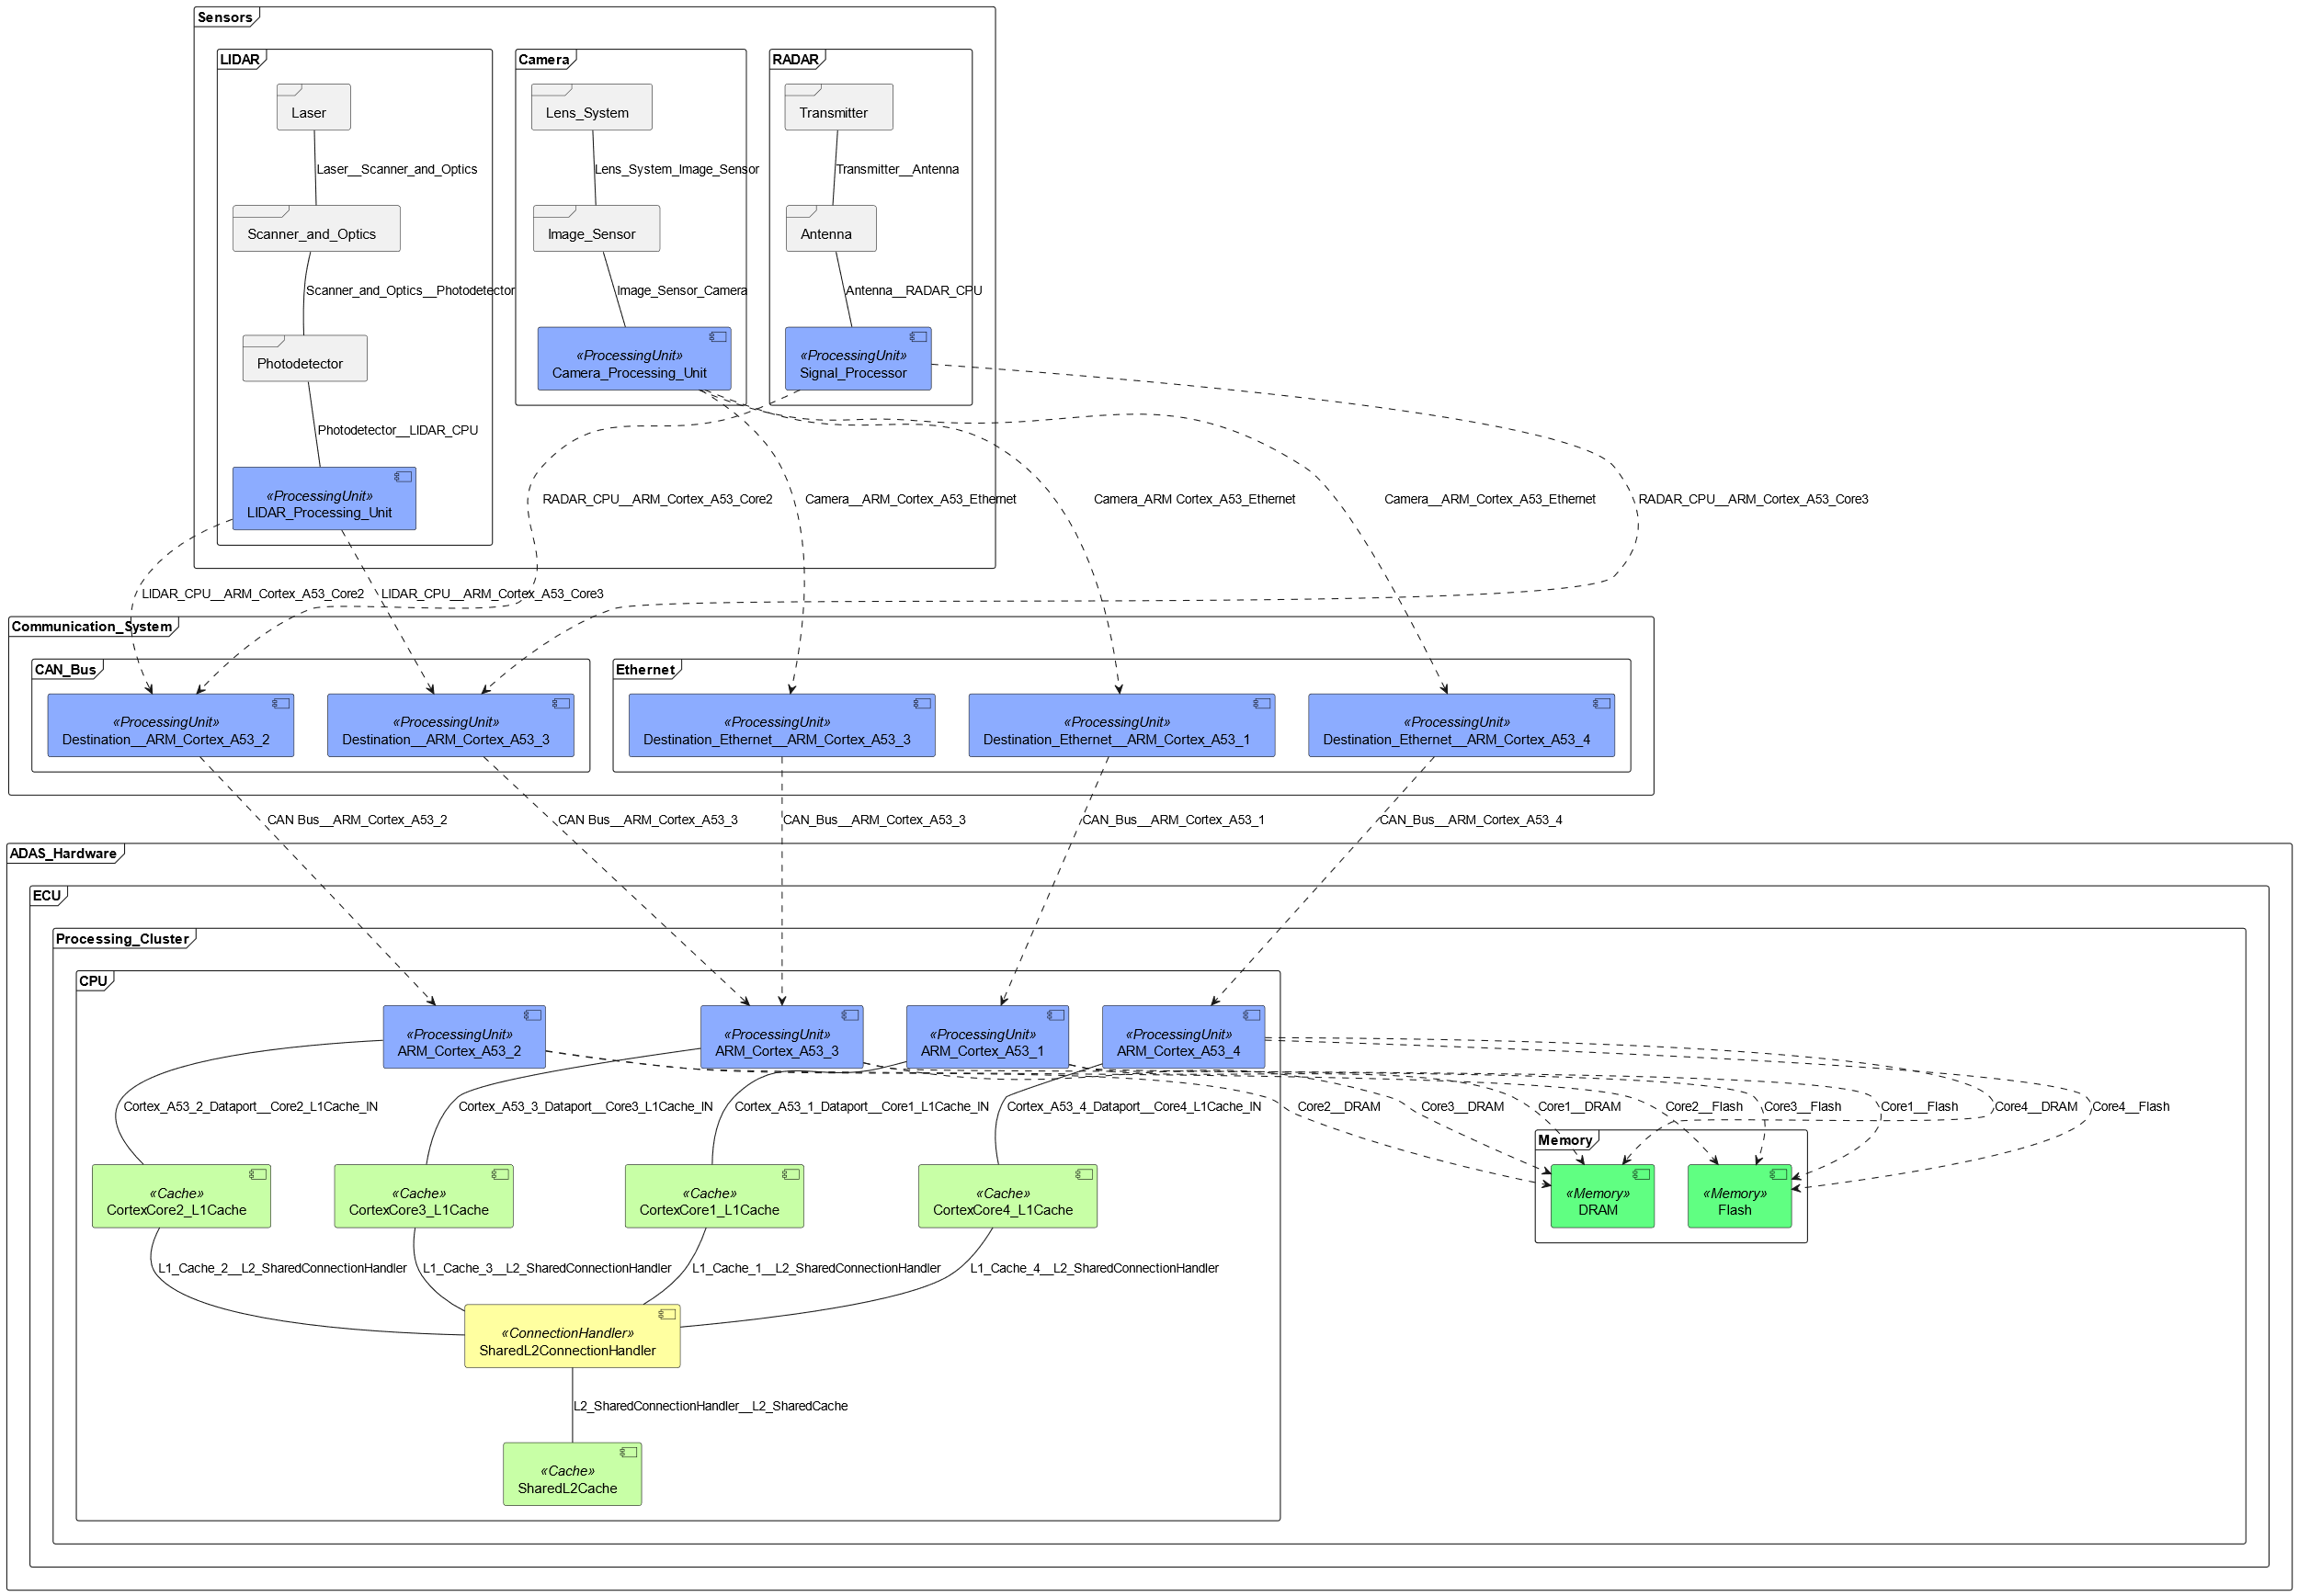
APP4MC Hardware Model

Slide 13

ADAS
Hardware
Mapping to Software
Overview of Software
Software

Slide 14

Software
Mapping of Hardware with
Runnables 39
Labels 35
Tasks 6

Slide 15

The Organizer - Scheduler
1 Device
4 CPUs
4 Schedulers
6 Tasks
2 Constraints

Slide 16

Tasks
ObjectDetection
DecisionMaking
SensorDataProcessing
Classification
ActuatorControl (Connection)

Slide 17

Task Runnables
Getting Vehicle State
Getting Vehicle Speed
Calculation of ABS
Brake Force Calculation
Monitoring of Brake, Wheel

Slide 18

Events
Start
BrakeForceActuation_start
BrakeActuatuorMonitor_start
BrakeForceCalculation_start

Slide 19

Events
Terminate
BrakeForceActuation_terminate
BrakeActuatuorMonitor_terminate
BrakeForceCalculation_terminate

Slide 20
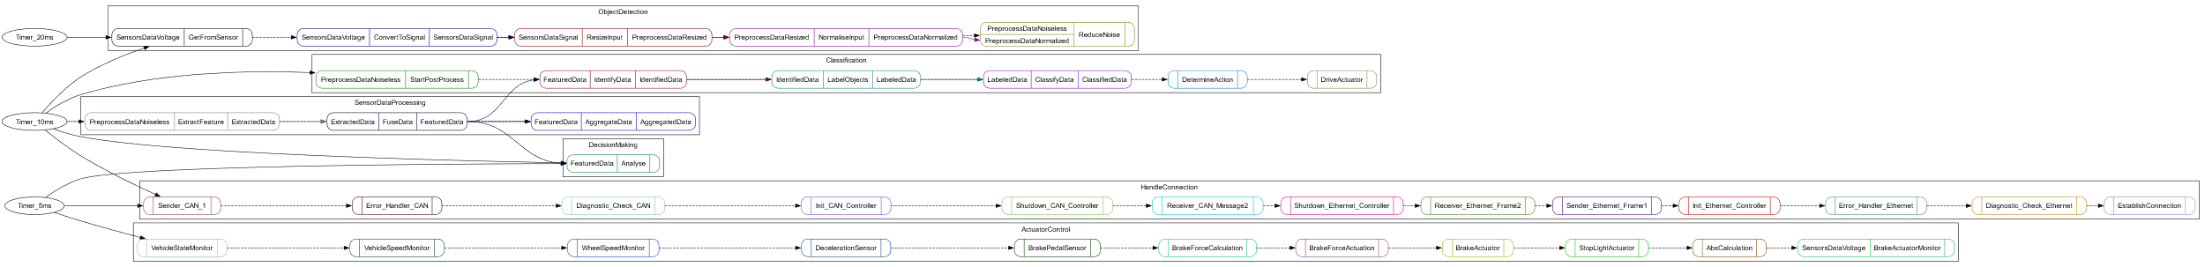
APP4MC Software Model

Slide 21

Thanks for your attention

